Slide 1
Life and Cell
LS1001 (BIOLOGY)
2020-21 : AUTUMN
SECTION G/ SLOT TK
Dr Bibekanand Mallick
Associate Professor
Department of Life Science
NIT Rourkela

Slide 2
Characteristics of Life
Organisms in nature possess unique features that allow biologists to identify them as living rather than nonliving.
They are as follows:
Cellular Organization
Growth
Reproduction
Movement
Adaptation
Metabolism
Specific organization
Homeostasis
Respond to environment

Slide 3
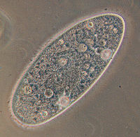
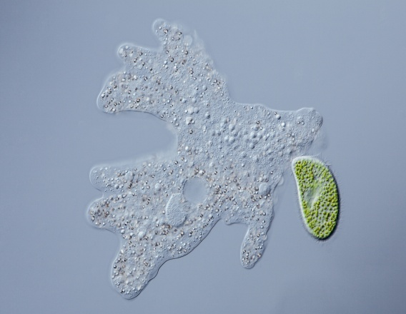
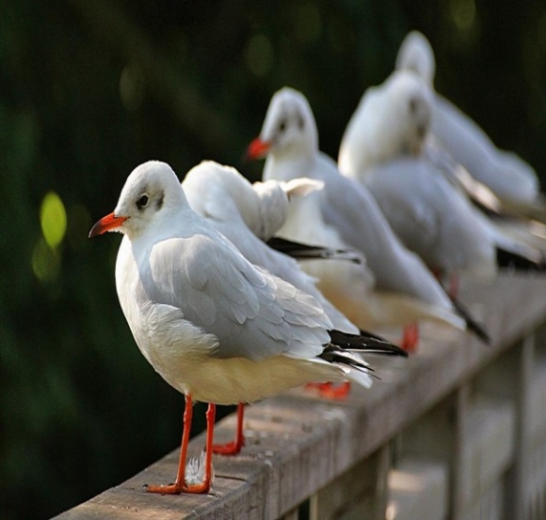
#1 Organization
All living organisms are made up of at least one cell
Unicellular - one celled organisms.
Eg. Paramecium, amoeba
Multicellular – more than one cell.
Eg. Humans, plants, animals
Cells are not found in nonliving things.
Paramecium
amoeba

Slide 4
Unicellular vs Multicellular
Unicellular organism | Multicellular organism
Body is made up of single cell | Body is made up of numerous cells
Division of labour is at the organelle level. It gives a low level of operational efficiency | Division of labour may be at cellular, tissue, organ and organ system level. It gives high degree of operational efficiency
A single cell carries out all the life processes | Different cells are specialized to perform different functions
The cell body is exposed to the environment on all sides | Only outer cells are specialized to face the environment. Inner cells are devoted to other functions

Slide 5
Unicellular vs Multicellular
An injury of the cells can cause death of the organism. | Injury or death of some cells does not affect the organisms as the same can be replaced by new one.
A cell body cannot attain a large size because of the limit imposed by surface area to volume ratio | A multicellular body can attain a large size increasing the number of small cells
Lifespan is short due to heavy load of work | Lifespan is long due to limited load of work for each cell type
Power of division is not lost | Certain specialized cells lose power of division
A well-marked capacity of regeneration is present | The capacity of regeneration decreases with increasing specialization
The cell has the same role for itself and the organism | Cells have a double role. One for themselves and other for the organism

Slide 6
#2 Growth
Two Basic types of Growth
Increase in cell size (unicellular)
Increase in cell number (multicellular)

Slide 7
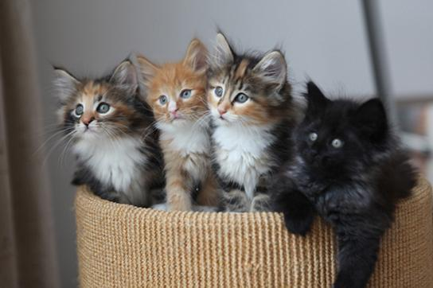
#3 Reproduction
Reproduction is the ability to produce a new organism of the same type.
It is not essential for the survival of an individual organism, but it is essential for the continuation of a species (a group of organisms that can interbreed and produce fertile offspring in nature).
Asexual- cell division (mitosis)—one cell becomes two Eg. bacteria
Sexual- two different cells join to form one new individual. New individual is different from either parent. Eg. plants and animals
Fertilization - union of the egg and sperm.
Zygote - new cell formed as a result of fertilization. Most complex organisms reproduce in this way.

Slide 8
#4 Movement
3 types:
Place to Place - (eg. bear running, bird flying, etc)
External Part - (eg. + phototropism, plants orient leaves toward sun)
Internal - (e.g. cytoplasmic streaming)

Slide 9
#5 Adaptation
Changing to meet the needs of the environment
Examples:
Bird migration ? - behavioral adaptation
food, nesting places
Human body temperature - physiological adaptation
Hibernation ?- physiological adaptation
(conserve energy to survive adverse weather conditions or lack of food; Frog)

Slide 10
#6 Metabolism
Set of chemical reactions that convert “food” into energy
# 7 Specific Organization
Certain parts do specific jobs (eg. heart, nucleus, chloroplasts, etc)

Slide 11
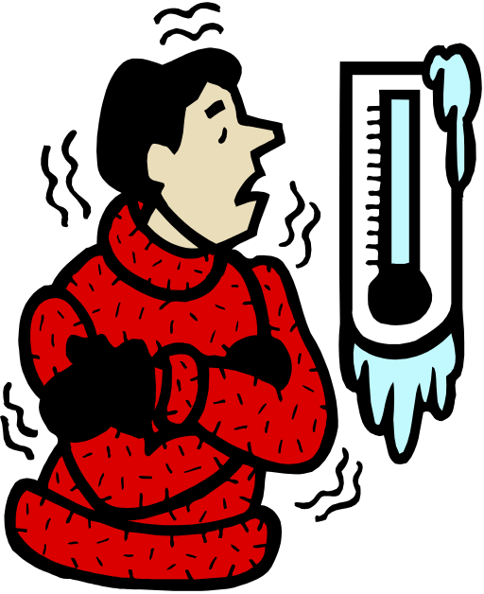
#8 Homeostasis
Maintaining the same state
Homeo = same, steady
Stasis = state
Examples:
Water balance inside and outside of cell
Human body temperature
Blood pH is tightly regulated.
Pancreatic hormones work to regulate blood glucose.
Cells function best when these are in balance

Slide 12
# 9 Respond to Environment
Stimulus - a change in the environment
  Eg. light, heat, pH, vibration, smell, etc.– earthworms respond to all of these.
Response - reaction to the change.
  Eg. pupils get smaller.
Essential for any organisms to-
  Escape predators
  Find food
  Move to light
  Move away from toxins
  Find a mate

Slide 13
Properties of Life
In summary, living organisms:
  are composed of cells (Cellular Organization)
  are complex and ordered (Ordered Complexity)
  respond to their environment (Sensitivity)
  can Grow, Develop and Reproduce
  obtain and use energy (Energy Utilization)
  maintain internal balance (Homeostasis)
  allow for Evolutionary Adaptation

Slide 14
Levels of organization of life
Level of organization | Explanations | Examples
Organelle | Smallest particle in a living cell that perform specific function. | Ribosome, mitochondria
Cell | Cells are smallest unit of life that perform specific functions and enclosed by membrane or cell wall. | Muscle cells, nerve cell, skin cells
Tissue | Made up of group of cells performing similar functions. | Muscle, nerve tissue
Organ | These are made multiple types of tissues that work together to complete a specific task. | Brain, heart, stomach
Organ system | Comprised of group of organs that perform a more generalized set of functions. | Circulatory system, nervous system
Organisms | An organism is comprised of several organ systems that function together. | Human, Tree
Ecosystem | Comprised of group of organisms and all non-living beings that live in a concrete area. | Forest, valley
Biosphere | Group of all the ecosystems that exist on the Earth

Slide 15
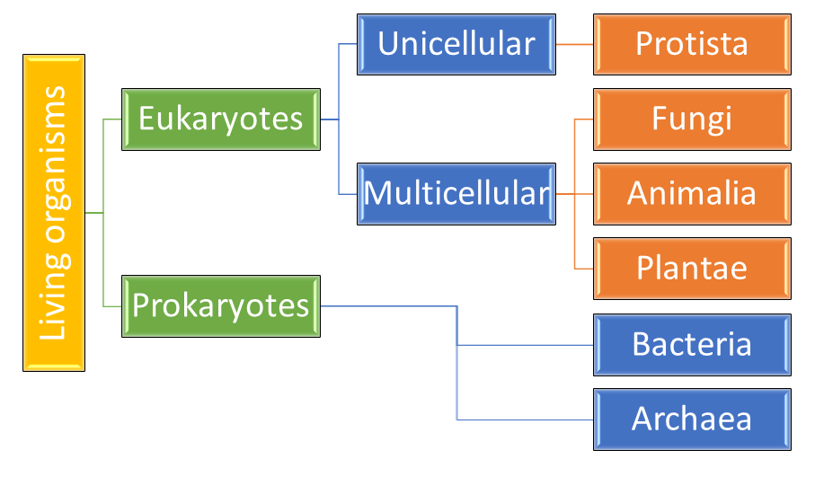
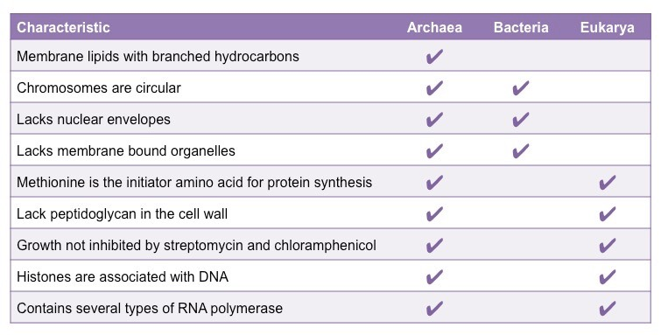
Molecular taxonomy- three major kingdoms of life

Slide 16
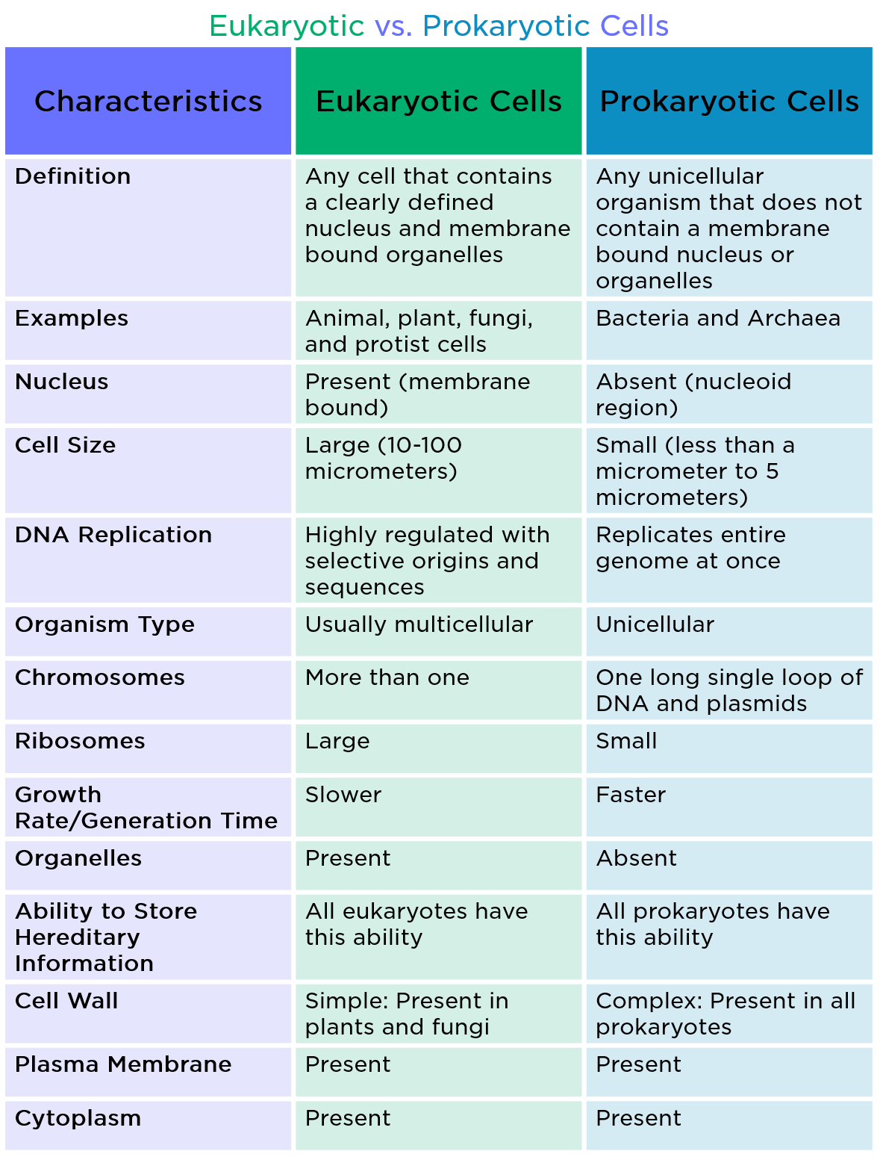
Classes of cells

Slide 17
Cell – Important Features
Grow
Repair and Maintain
Reproduce
Undergo change
Move
Respond
Grow old and die
Why basic unit of life??
- Smallest of biological structure that perform all basic activities of life
‘Cell’ was discovered and coined for the first time in 1665 by Robert Hooke using the compound microscope devised by him

Slide 18
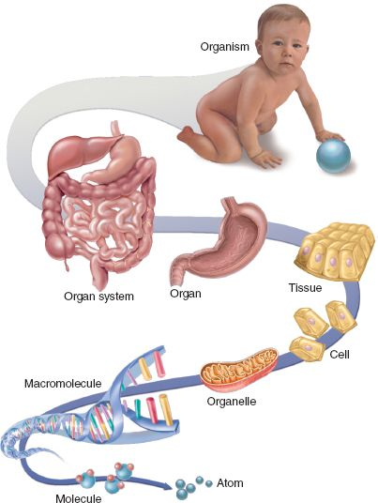
Cellular Hierarchy

Slide 19
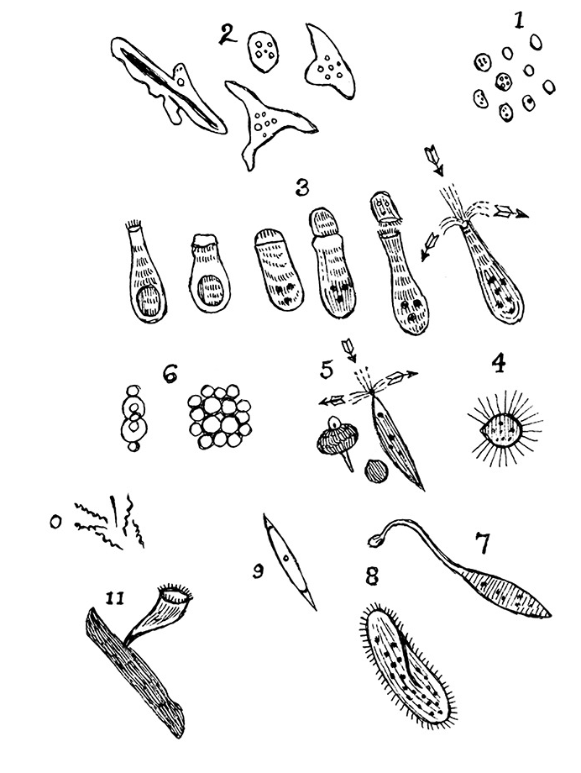
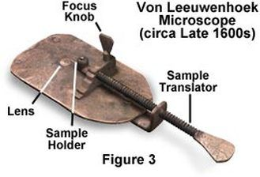
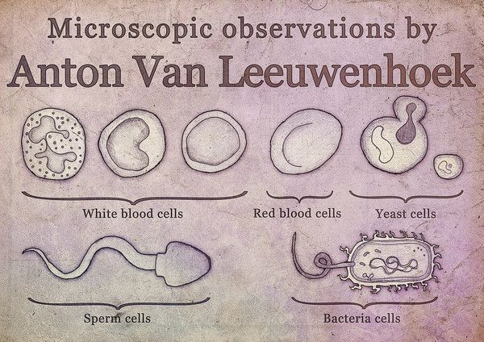
Cell theory –
Anton van Leeuwenhoek
He made use of a microscope containing improved lenses that could magnify objects almost 300-fold
Under these microscopes, Leeuwenhoek found motile objects and he states that motility is a quality of life, therefore these were living organisms

Slide 20
Cell theory
In 1804, Karl Rudolphi and J.H.F. Link were awarded the prize for "solving the problem of the nature of cells", meaning they were the first to prove that cells had independent cell walls by the Königliche Societät der Wissenschaft (Royal Society of Science), Göttingen
After the discovery of cells, many debates started about properties, role and function of cells
In biology, cell theory is a scientific theory which describes the properties of cells
Cell theory is the foundation of biology and is the most widely accepted explanation of the function of cells
In 1838, Cell theory was formulated by Matthias Schleiden and Theodor Schwann.
Other scientists like Rudolf Virchow also contributed to the theory

Slide 21
Cell Theory
Schleiden suggested:
  Cells or result of cells contribute to structural part of a plant
    Cells are made by a crystallization process either within other cells or from the outside
  Schwann suggested:
  Like plants, structurally animals are composed of cells or the product of cells
The following are the three basic principles to this cell theory:
  1. All living organisms are composed of one or more cells
  2. The cell is the most basic unit of life in all living things
  3. All cells arise from pre-existing living cells (Contributed by Rudolf Virchow in 1855) "Omnis cellula e cellula"

Slide 22
Modern Cell Theory
Contains four statements, in addition to the original Cell Theory:
The cell contains hereditary information (DNA) which is passed on from cell to cell during cell division.
All cells are basically the same in chemical composition and metabolic activities.
All basic chemical & physiological functions are carried out inside the cells. (movement, digestion, etc).
Cell activity depends on the activities of sub-cellular structures within the cell (organelles, nucleus, plasma membrane).

Slide 23
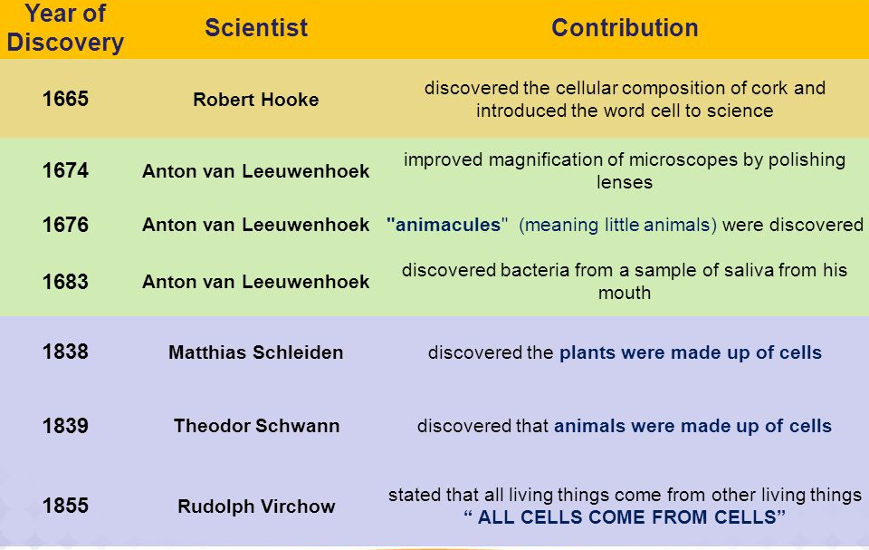

Timeline of Cell Theory

Slide 24
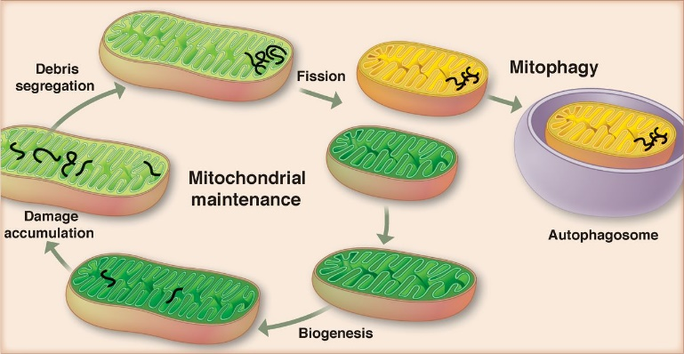
Cell theory – Exception
Viruses are the exception to cell theory because they are made up of proteins and one of the nucleic acid (DNA or RNA), lack protoplasm and metabolism. So, they are not cells.
The first cell did not come from another cell
Mitochondria and chloroplast have their own genetic material and can reproduce independently from the cell in which they reside.

